Slide 1
Pairs Trading on the S&P 500
Can statistical arbitrage beat buy-and-hold on a risk-adjusted basis?
Financial Markets Analytics — Final Project (Variant A)
Prof. G. Forte · A.Y. 2025/2026 · University of Milano-Bicocca

Slide 2
Research question & approach
Gatev, Goetzmann & Rouwenhorst (2006) — cointegration variant
▪ Question. Does a market-neutral pairs-trading portfolio deliver better risk-adjusted returns than buying and holding the S&P 500?
▪ Universe. Survivorship-bias-free S&P 500 constituents: 1,355 stocks that were ever in the index, 1990–2018 (professor's Bloomberg dataset).
▪ Two phases, rolled forward. 3-year formation window to select cointegrated same-sector pairs (Engle–Granger), then 26 weeks of out-of-sample trading — repeated 52 times, 1993–2018.
▪ Signals. Weekly z-score of the spread: open at |z| > 2, close at |z| < 0.5, stop at |z| > 3, force-close at window end.
▪ Judgement. Everything measured net of 10 bps/turnover costs and compared with the index on Sharpe, volatility, drawdown.

Slide 3
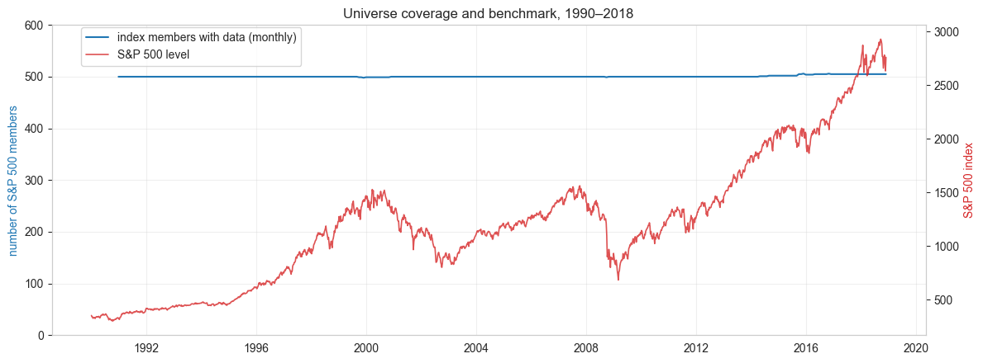
Data: a survivorship-bias-free universe
SPX500 Original.xlsm → extract_data.py → Parquet caches
▪ 1,355 tickers, weekly Friday closes, 1990–2018 (1,509 weeks).
▪ Membership mask. A stock is tradable only in months with positive index weight — delisted names included while members.
▪ ~500 members every month, exactly as the real index.
▪ Benchmark. S&P 500 index level from the same workbook.

Slide 4
Data cleaning — documented, as required
▪ Sector map off-by-one (our best catch). The Sector sheet holds unevaluated Bloomberg formulas; the 0/1 sector sheets have headers shifted by one column vs the data — read naively, ExxonMobil lands in Consumer Cyclical and JPMorgan in Industrial. We re-aligned data column c to the c-th master ticker and verified 30/30 well-known companies correct (vs ~6/30 naive).
▪ Quality filters at formation. Complete 3-year history, price ≥ $5, no weekly move > 50% — removes penny stocks and unadjusted corporate actions that fake cointegration.
▪ Delistings inside a trading window. Prices forward-filled; the pair is force-closed at the last date both legs quote.
▪ Weekly frequency. Friday closes (assignment: weekly or monthly, never daily).

Slide 5
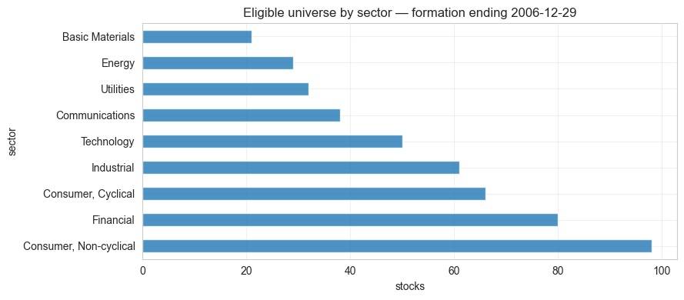
Formation: Engle–Granger scan within sectors
All same-sector combinations, both orderings — ~0.2 ms per test
▪ Cointegration regression. log y = α + β·log x + ε on 156 weeks; ADF test on residuals (statsmodels coint).
▪ Survivors need: p < 0.05, hedge ratio β ∈ [0.1, 10], spread half-life 1–26 weeks.
▪ Ranking. Sort by p-value, greedy pick — each stock in at most one pair — until 20 pairs.
▪ Freeze. α, β, μ, σ frozen at formation end: the trading window is genuinely out-of-sample.
▪ Result. All 52 windows fill the full 20-pair book.

Slide 6
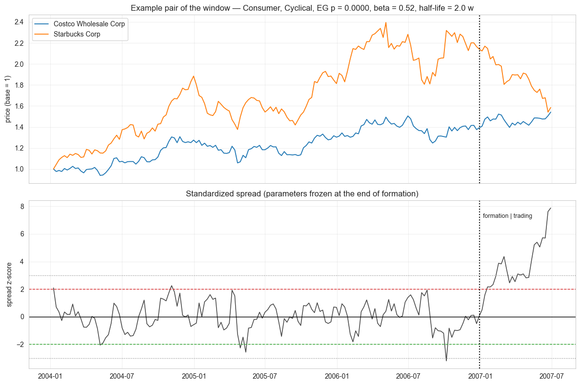
One pair under the microscope
Formation 2004–2006, trading H1-2007 — and a live cointegration breakdown
The spread breaks +3σ out-of-sample → stop-loss fires and locks the pair: exactly the risk the stop rule exists for.

Slide 7
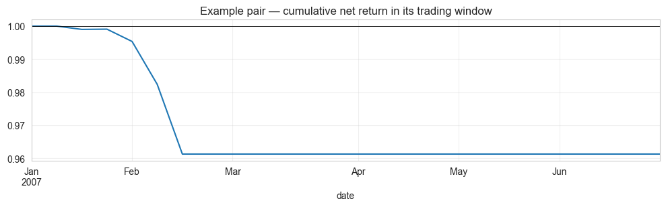
Trading rules & P&L accounting
Weekly, on the frozen z-score
▪ Open long spread at z ≤ −2 (long y, short βx), short spread at z ≥ +2.
▪ Close when |z| < 0.5 — the spread has reverted.
▪ Stop-loss at |z| ≥ 3, pair locked for the window.
▪ Max holding. Force-close after 26 weeks.
▪ Costs. 10 bps per unit of turnover ≈ 20 bps per round trip.
▪ Capital. 1/20 per pair; gross exposure = capital (wy = 1/(1+β) long, wx = β/(1+β) short).

Slide 8
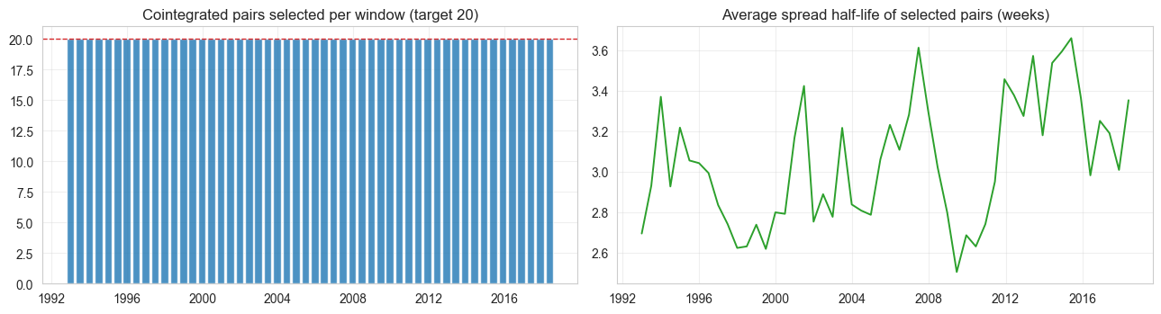
Walk-forward simulation: 52 windows, 1993–2018
Re-select, re-estimate, trade out-of-sample, roll — no look-ahead anywhere
Every half-year the book is rebuilt from scratch with only past data. Chaining the 52 windows gives 1,352 weeks (~26 years) of genuinely out-of-sample weekly returns.

Slide 9
Headline results vs the S&P 500
 | Pairs (net) | Pairs (gross) | S&P 500
Total return | -7.23% | +1.43% | +498.62%
CAGR | -0.29% | +0.05% | +7.12%
Ann. volatility | +1.53% | +1.52% | +16.41%
Sharpe (rf = 0) | -0.18 | 0.04 | 0.50
Max drawdown | -13.55% | -10.09% | -56.24%
Corr. with S&P 500 | 0.09 | 0.09 | —
Beta vs S&P 500 | 0.01 | 0.01 | —
Net of costs the strategy does NOT beat buy-and-hold — but look at the risk rows: a tenth of the index volatility, a quarter of its drawdown, zero beta.

Slide 10
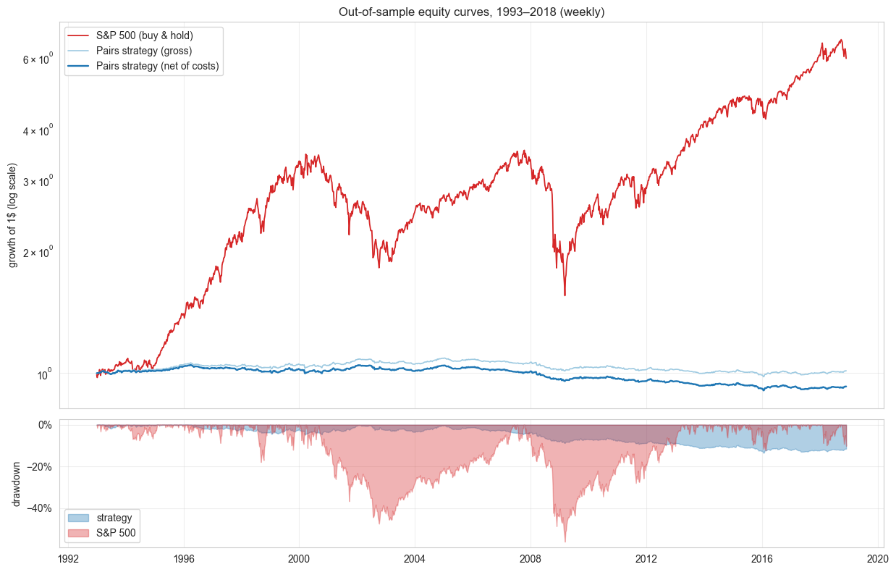
Out-of-sample equity curves

Slide 11
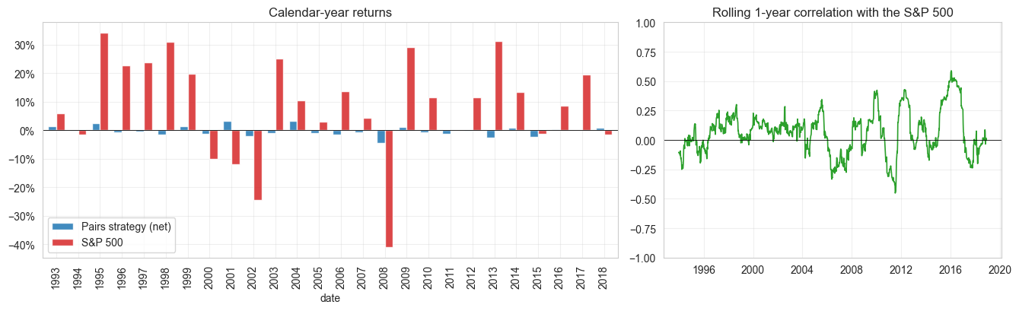
Market neutrality, verified in the data
2008: strategy -4.6% while the S&P 500 lost -41.0%. Rolling 1-year correlation oscillates around zero — the equity curve is driven by spread convergence, not by the market.

Slide 12
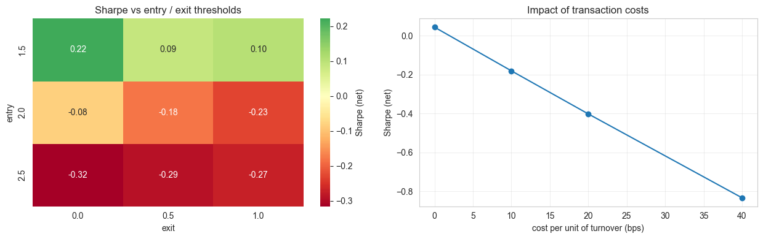
Sensitivity: thresholds & the cost knife-edge
Selection kept fixed; only the trading layer re-run
Sharpe stays near or below zero across the whole entry/exit grid → the weak net result is structural, not a parameter accident. The strategy only survives execution below ~10 bps per trade.

Slide 13
Conclusions
▪ No, net of costs. Risk-adjusted, pairs trading (Sharpe -0.18) did not beat S&P 500 buy-and-hold (Sharpe 0.50) over 1993–2018.
▪ The construction delivers. Beta 0.01, correlation 0.09, max drawdown -13.55% vs -56.24% for the index; only -4.6% in 2008 while the market lost -41.0%.
▪ The edge was real — in the 1990s. 1993–2002: gross Sharpe 0.36, still positive (0.14) after costs — cointegration genuinely predicted mean reversion.
▪ And it has since disappeared. 2003–2018: even gross Sharpe turns negative (-0.20); costs subtract another ~0.2. Not a parameter issue — the signal itself decayed.
▪ We reproduce the literature. Gatev et al. (2006): profits fading through the 1990s; Do & Faff (2010): gone afterwards. Our independent implementation confirms it on 1993–2018.

Slide 14
Limitations & extensions
▪ Cointegration breakdown — mergers, regime shifts; stop-loss + max holding are the defences.
▪ Multiple testing — thousands of tests breed false pairs; sector restriction + half-life filter + out-of-sample design mitigate.
▪ Benchmark is a price index (no dividends); borrow fees / cash interest also unmodelled — omissions on both sides.
▪ Execution — Friday closes, flat cost rate, shorting assumed available.
▪ Monthly-frequency comparison.
▪ Johansen test / distance method as alternative selection.
▪ Volatility-scaled capital allocation.
▪ Kalman-filter time-varying hedge ratio.
▪ Stoxx 600 European universe replication.
References: Gatev, Goetzmann & Rouwenhorst (2006) RFS · Do & Faff (2010) FAJ · Vidyamurthy (2004) · Engle & Granger (1987)

